Slide 1
Microsoft Graph Data Connect
Introducing Microsoft Graph Data Connect & configuring your Office 365 tenant

Slide 2

Microsoft Graph Data Connect
What is Microsoft Graph Data Connect?
What types of scenarios does Microsoft Graph Data Connect enable?
Configuring your Office 365 tenant to enable Microsoft Graph Data Connect

Slide 3
What are customers trying to do?
Better CRM
Security and Fraud
Optimize Your Organization​
Build & Integrate Intelligent Workflows with O365​
Mine your org network for a customer introduction
Opportunity health assessment​
Detect fraud with productivity and communication data
Mine communication for interaction patterns with users outside the organization
Find an expert​
Automate knowledge base creation​
Understand resource utilization within your organization
Case management
Questions & answers bot
Support ticket management
Analytics
AI and ML
Index and Search

Slide 4
Challenging scenarios with the Microsoft Graph
Today’s most interesting data-driven applications
require reasoning & analysis over massive datasets
built by extracting data from Office 365 via Microsoft Graph APIs
Microsoft Graph is optimized for simple, real-time, entity centric queries, not:
Data Access in bulk - requires expensive engineering
Data Privacy is at risk - given the current all-or-nothing consent models
Data Security & Data Governance - entirely up to the experience author

Slide 5
What is Microsoft Graph Data Connect?
Creates a new model for data access & hosting applications within the customer’s control
Allows developers to build intelligent applications and experiences using Office 365 data & Azure resources
All customer data remains within the Microsoft secure cloud
Microsoft Graph remains the best approach for enabling end-user task centric apps

Slide 6
Benefits to Enterprise Customers
Granular access to only the specific datasets/fields required for developer app
Customer gets to review the specific fields and any exclusions
Data is stored, processed, accessed within the customer Azure tenancy
Only data the customer explicitly approves is shared with the application developer
Data policy promises hold true at all times
Policies like encryption, auditing, etc. are in place when data moves from Office 365 into Azure
Developer app is “managed” with no effort from the customer
Deployed, scaled, updated, with minimal customer intervention

Slide 7
Benefits to Developers & ISVs
Application logic runs within Azure’s customer sandbox
Developer doesn’t need to be trusted with/liable for hosting data
Data layout optimized for analytics applications
Focus on building value rather than coercing user-mode APIs into analytics scenarios
Azure data services and tools
Leverage the full stack ‘better together’ tooling that Azure + VS + O365 provides
1-click install for your app through marketplace or service catalog (internal distribution)
Easy to manage/scale/update even in the customer’s tenancy

Slide 8
Comparing Microsoft Graph APIs & Microsoft Graph Data Connect
 | Graph APIs | Graph Data Connect
Data Access | Single/few items accessed at a time from a single user or group | Data access across multiple items* within or across users or groups
Access Pattern | Real time synchronous access to the data Consumer only defines "what" data they want | Scheduled access to data (scheduled granularity could be hours, days, …) Consumer define "what" data they want, "when" do they want that data & "where" do they want that data
Data Operations | Read + Write access to the master data | Read only access to copy of the data
Data Governance | No control over data once it’s extracted | Data can only be extracted into customers own storage, and can have policies monitored like encryption at rest, auditing, etc.
Access permissions | Access permissions are scoped to each resource type (mail, file, events, etc.) Permissions can be scoped for a single user, group or the entire tenant. | Access permissions can be granularly scoped to individual properties/field within a resource type. Permissions can be scoped to a list of users, groups or the entire tenant. Approver can also deny access for data from specific user

Slide 9
Graph Data Connect - Enabling Scenarios
Data resides in Office 365
Azure Data Factory extracts data via Graph Data Connect
Graph Data Connect enforces only approved requests for data
Extracted data is stored in Azure:
Azure Blob Storage
Azure Data Lake
Etc.
Create solutions that leverage the data in Azure

Slide 10
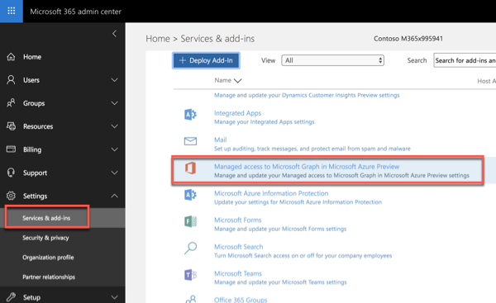
Configuring Office 365 & Microsoft Azure
Office 365 Requirements:
Enable Graph Data Connect in your Office 365 tenant
Designate security group that can approve data extraction requests
Microsoft Azure Requirements:
Minimum of two (2) users with global administrator role assigned
Azure Active Directory application

Slide 11
Demo Configuring Your Office 365 Environment

Slide 12

Summary
What is Microsoft Graph Data Connect?
What types of scenarios does Microsoft Graph Data Connect enable?
Configuring your Office 365 tenant to enable Microsoft Graph Data Connect

Slide 13
Reading further
Microsoft Graph
https://graph.microsoft.com

Slide 14
Thank you.

